Slide 1

Mind Menders Solution Type: Web Application
Names of Team Members
Mohamed Faraazman Bin Farooq S - Lead
Aania Sohail
Notes:
Korrie

Slide 2
The Opportunity
Mental Health Needs a New Lens
Workplace stress affects 77% of professionals, yet real-time awareness is nearly zero.
Traditional mental health support is reactive, not proactive.
There’s no lightweight, real-time solution using non-invasive tech.
Big players overlook micro-level stress indicators, we don't.
Notes:
Korrie
updated 7/21

Slide 3
Solution
AI-Based Real-Time Stress Detection via Webcam
Built with ViT (Vision Transformer) deep learning model.
Detects stress in real time using a standard webcam.
Displays stress percentage and overlays facial tracking live.
Stores stress analysis history (SQLite + Flask backend).
Colorful, user-friendly frontend, works offline on localhost.
Notes:
Korrie
updated 7/21

Slide 4
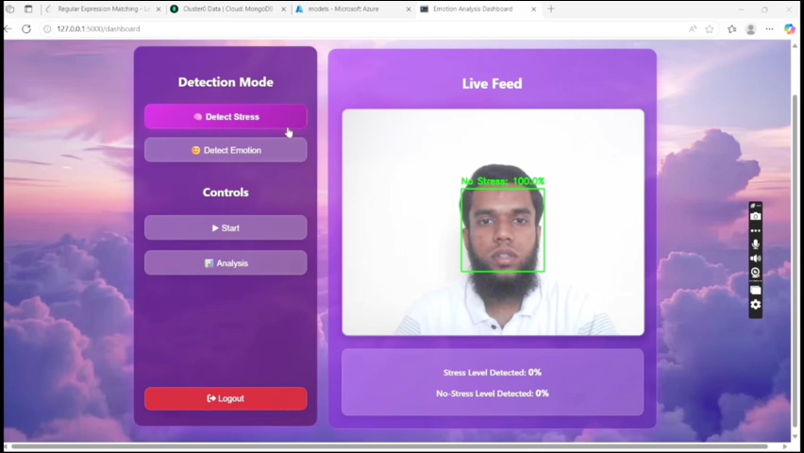
Demo
Notes:
Korrie
updated 7/21

Slide 5
Takeaways
It’s Time to Rethink Emotional Intelligence
❌ Stop relying only on self-reported surveys.
✅ Start using real-time, AI-powered emotion detection.
✅ No wearables. No cloud. Just a webcam.
🕒 Save time.
💰 Cut costs.
🧠 Improve awareness.
Notes:
Korrie
updated 7/21

